Slide 1

PRINT JOB
MANAGEMENT
SYSTEM
NAME:DILANI R
REG NO:8115U23EC023
DEPARTMENT:ECE
SUBJECT: DATA STRUCTURES

Slide 2
CONTENT
INTRODUCTION
KEY FEATURES
DATA STRUCTURES USED
WORK FLOW AND MODULE
PROS AND CONS
CONCLUSION

Slide 3

INTRODUCTION
Efficient job management is critical for the success of any organization, large or small.
A well-designed job management system can streamline workflows, improve productivity, and enhance customer satisfaction.
This presentation will provide an in-depth look at the key features, pros and cons of implementing a job management system.

Slide 4

KEY features
Task Scheduling
Allows users to create, assign, and manage tasks with due dates and dependencies.
Resource Allocation
Enables efficient distribution of personnel, equipment, and other resources across multiple jobs.
Reporting and Analytics
Provides real-time dashboards and customizable reports to track progress, identify bottlenecks, and make data-driven decisions.

Slide 5
DATA STRUCTURES USED
The C program used for the printing job management system, the primary data structure used is a queue.
A queue is a linear data structure that follows the FIFO (First-In-First-Out) principle.
Printing Job Structure:
The Printing Job structure represents a single printing job in the queue.
Printing Queue Structure:
The Printing Queue structure represents the printing queue itself.
Functions:
InitializeQueue()
IsEmpty()
Enqueue()
Dequeue()
DisplayQueue()

Slide 6

MODULE COMPLETION
JOB CREATION
Users can easily create new job requests, set priorities, and assign them to team members.
TASK DELEGATION
The system distributes tasks based on team member skills, availability, and workload.
DISPLAYING THE JOBS
Printing the jobs present in the queue.
1
2
3

Slide 7
WORK FLOW
Data Structures: The Job, Person, and Queue structures are defined here.
Queue Operations: The createQueue, enqueue, dequeue, and printQueue functions are defined here to handle queue operations.
Task Assignment: The assignTasks function is defined here to assign tasks to a person based on their skills.
Main Function: The main function is defined here, which is the entry point of the program. It prompts the user to enter the number of jobs, creates a queue, and enters a loop to handle user interactions.

Slide 8
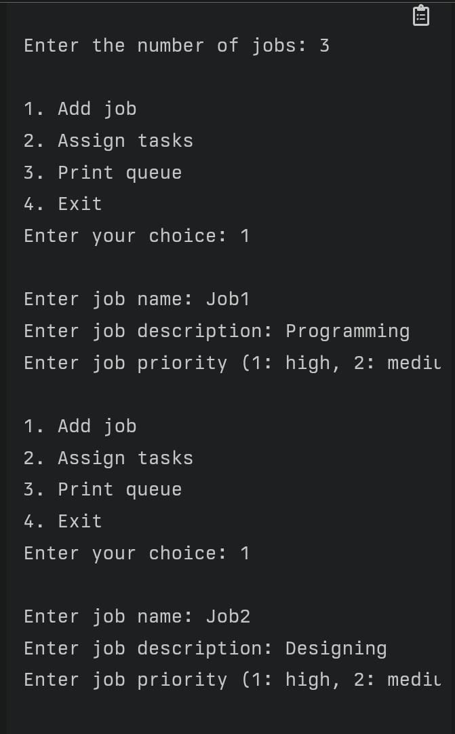
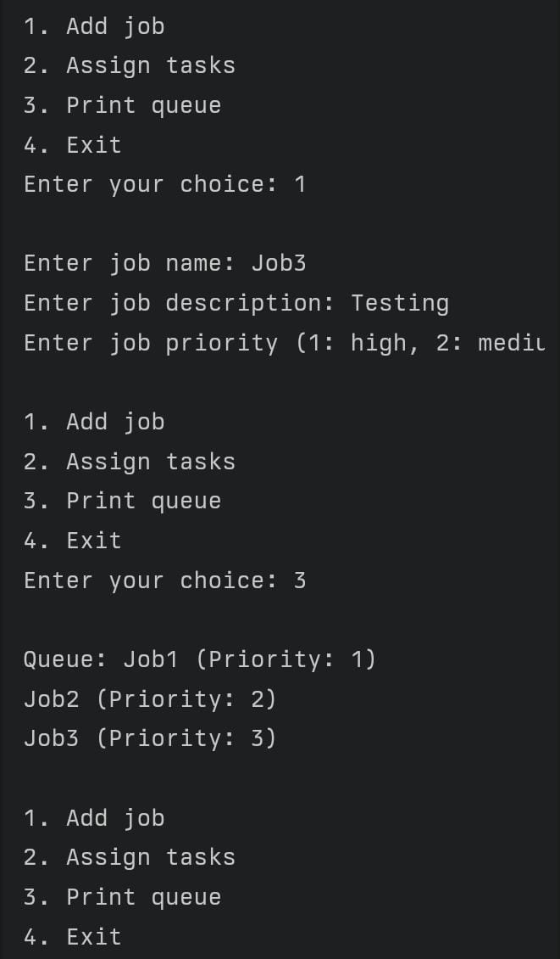
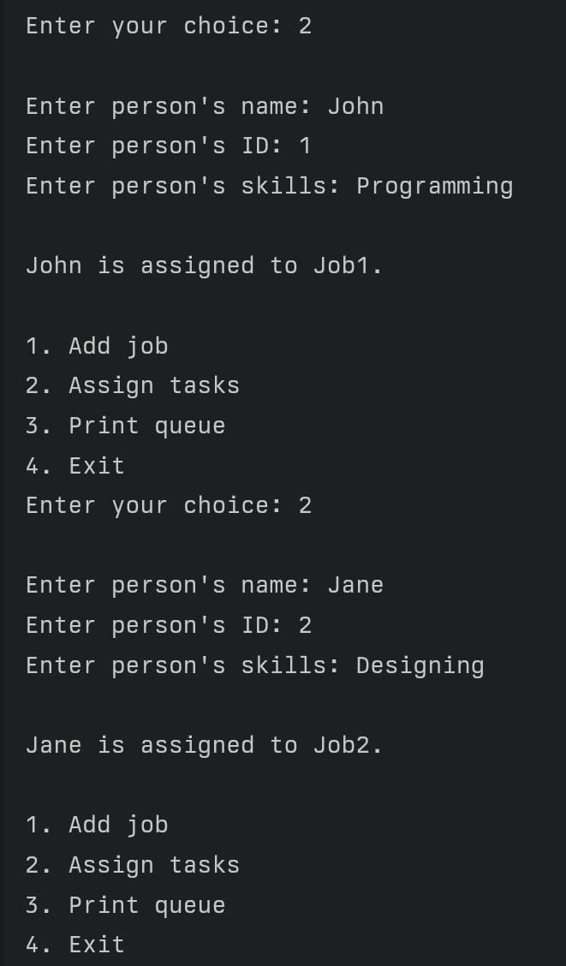
OUTPUT

Slide 9


PROS
Increased productivity and efficiency
Improved resource utilization and cost savings
Enhanced collaboration and communication
Better visibility and control over job progress
CONS
Initial setup and integration costs
Potential resistance to change from employees
Ongoing maintenance and software updates required
Potential data security and privacy concerns

Slide 10



CONCLUSION
SCALABILITY
Easily accommodates the evolving needs of the organization, making it a long-term solution for efficient operations.
CUSTOMER SATISFACTION
Improves communication, along with delivering jobs on time, and significantly enhance the overall customer experience.
IMPROVED COMMUNICATION
Centralized platform for job details, task assignments, progress updates, cross-team collaboration and communication.

Slide 11

Thank You

